Slide 1
Toy Store Inventory Management System
Subject : INFO 5100 - Application Engineer & Dev

Slide 2
INTRODUCTION
Project Overview: Welcome to the presentation on our Inventory Management Application development project. In a world where efficient management of resources is crucial, our project addresses the need for a robust system to streamline and optimize inventory processes.
Importance of Inventory Management: Effective inventory management is the backbone of any successful business, ensuring that products are available when needed while minimizing carrying costs. Our application aims to enhance these processes, providing a user-friendly and efficient solution.
Purpose of the Application: The primary objective of our project is to design and implement a comprehensive Inventory Management System using Java. This system will offer a centralized platform for businesses to track, manage, and optimize their inventory, leading to improved efficiency, reduced errors, and enhanced decision-making.

Slide 3
Objectives
Efficient Inventory Tracking:
Develop a system that enables real-time tracking of inventory levels, ensuring accurate and up-to-date information on product availability.
User-Friendly Interface:
Design an intuitive and user-friendly interface to facilitate easy navigation for the stakeholders.
Scalability and Adaptability:
Build a scalable system capable of accommodating the growing needs of businesses, ensuring adaptability to evolving inventory management requirements.

Slide 4
Technology Stack
Programming Language: Java
Utilizing the robust and versatile Java programming language for the development of the Inventory Management Application, ensuring platform independence and widespread industry support.
Integrated Development Environment (IDE): NetBeans
Employing NetBeans as the integrated development environment for Java, providing a feature-rich and user-friendly environment for coding, debugging, and testing.
UML Tools: Lucidchart, draw.io
Leveraging UML tools such as Lucidchart and draw.io to create detailed UML Class and Use Case diagrams, aiding in visualizing and communicating the system's structure and functionality.
Version Control: Git
Implementing Git for version control, allowing for collaborative development, tracking changes, and ensuring code integrity throughout the project.
Database Management System: MySQL
Implementing MySQL as the database management system to store, manage, and retrieve inventory data efficiently and reliably.

Slide 5
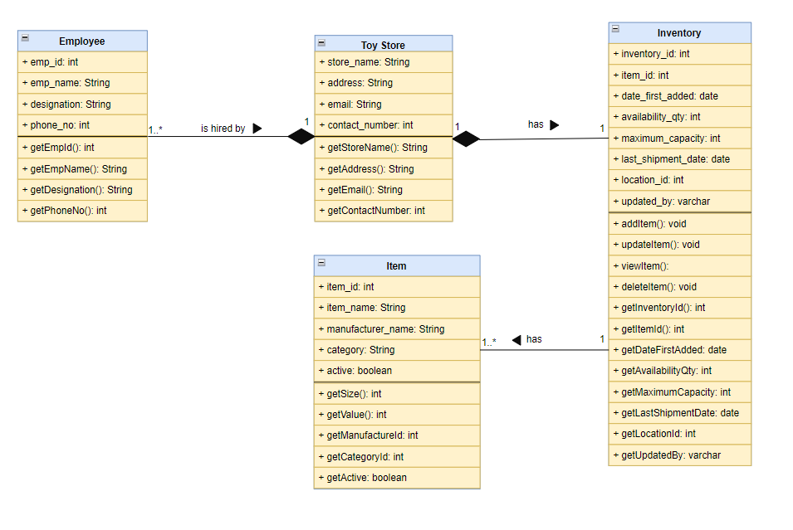
UML Class Diagram

Slide 6
Class Diagram - Key Classes
Inventory Class:
Attributes: inventory_id, item_id, date_first_added, availability_qty, maximum_capacity, last_shipment_date, location_id, updated_by.
Methods:
addItem
Description: Allows an actor (e.g., Employee) to add a new item to the inventory.
updateItem
Description: Permits an actor to update the information of an existing item in the inventory.
viewItem
Description: Enables an actor to view the details of a specific item in the inventory.
deleteInventory
Description: Allows an actor to delete an entire inventory record.
Actors:
Employee: Represents an actor interacting with the use cases.

Slide 7
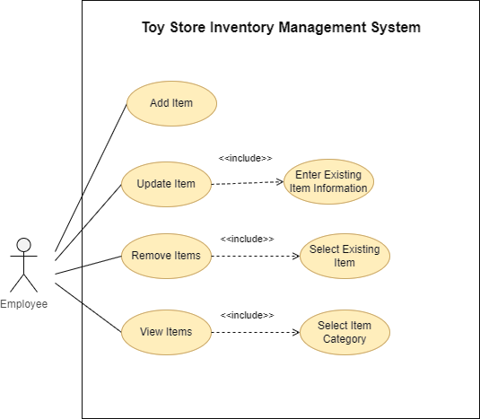
Use Case Diagram

Slide 8
Development Process
Waterfall Model
1. Requirements Gathering:
The project begins with a thorough analysis of the requirements among the team members. The objective is to define the functionality and features expected from the Inventory Management Application.
2. System Design:
In this phase, the system architecture is designed based on the gathered requirements. Detailed UML Class and Use Case diagrams are created to provide a visual representation of the application's structure and functionality.

Slide 9
Development Process CONTD.
3. Implementation:
The actual coding and implementation of the Inventory Management Application take place in this phase. Java is employed as the primary programming language, and developers follow best practices to ensure code modularity, readability, and maintainability.
4. Integration and Testing:
Components developed in the implementation phase are integrated to form a complete system. Rigorous testing, including unit testing, integration testing, and system testing, is carried out to identify and rectify any bugs or issues.
5. Deployment:
Once the application is thoroughly tested and approved, it is deployed to a production environment. This phase involves setting up the necessary infrastructure, configuring servers, and ensuring that the application is ready for use by end-users.

Slide 10
Development Process CONTD.
6. Maintenance:
Post-deployment, the system enters the maintenance phase. Ongoing support, updates, and bug fixes will be performed, as needed. This phase ensures the long-term sustainability and optimal performance of the Inventory Management Application.

Slide 11
Conclusion
In conclusion, the journey of developing our Inventory Management Application has been an exciting exploration of technology, methodology, and strategic decision-making. Through the integration of Java programming, UML Class and Use Case diagrams, and a carefully selected technology stack, we've endeavored to create a robust, user-friendly, and scalable solution to address the critical need for efficient inventory management.

Slide 12

THANK YOU

